Slide 1



Time-series Modeling, Analysis, Interface, and Insight from Entomological Electropenetrography
Auburn-USDA
Team: Zachary Traul (TL-S),
Devanshi Guglani,
Milo Knell,
Lillian Vernooy,
Mehrezat Abbas (TL-F)
Advisor: Prof. Gabriel Hope
Liaisons: Dr. Elaine Backus (USDA),
Dr. Anastasia Cooper (Auburn),
Dr. Kathryn Reif (Auburn)

Slide 2

Outline
01
Background
02
Project Goals
03
Accomplishments
04
Future Work

Slide 3

Notes:
Motivation [ Zach ]
USDA, Auburn
Emphasize importance of this tool to researchers
EPG background
WinDaq
Nothing made for mosquitos
Machine learning methods in EPG research are not particularly modern
Script:
Feeding the world (globe) is difficult and it is being made more difficult by climate change. Among many challenges, one of the biggest threats to crop and livestock production in the United States is invasive pests whose ranges are constantly expanding northward as our world warms. Among these pests are aphids (picture), sharpshooters (picture), and mosquitoes (picture), all of which feed on their unadapted hosts and pass along diseases that decimate (dead crops?) yields in the process. Clearly, this is bad. It concerns not just our sponsors at the US Department of Agriculture and University of Auburn, but the entire agricultural industry and by extension us, who rely on it for food everyday. To combat these pests, we need to understand how they feed to create targeted responses. So how do we do that? These pests (back to bugs), and particularly their mouths, are small. The ones we are concerned about use stylets (graphic) to puncture their hosts, hiding the feeding process from our view. One answer, the focus of our project, is called electropenetography or EPG (text on screen) for short. It is a difficult process that involves gluing thin gold wires onto insects under a microscope (picture), placing them on a host, and putting them into a circuit like so, where a very small amount of current flows through the insect, into the host plant, and back to the power source (picture). As the insect goes through the different stages of its feeding, the voltage across the insect, which is essentially a resistor, changes as it punctures cells walls, blood vessels, salivates, and otherwise feeds on its host. Plotting this voltage against time, entomologists create an EPG recording which looks something like this (picture). Their next step is to segment this graph based on what stage of feeding the insect was in. As an example, take this EPG recording of a mosquito feeding on a human hand and its corresponding segmentation. It’s not important to understand exactly what’s happening, but to give some context about what information can be extracted, we know that this point here (circle on EPG recording) is when the mosquito first punctured the host’s skin. Here is where it began ingesting blood (circle), and here is where it removed its stylet (circle) and flew away. Among many uses of this is giving us insight into how a pesticide does or does not work against a novel pest. Of course, we need labelled data to do this analysis, a process that is incredibly time consuming for our sponsors and lacks purpose-made software, making it difficult to run large-scale experiments. The software they currently use (picture), can hardly be called modern. The limited algorithms that exist for automatically labeling recordings are species-specific (largely made for aphids) and do not extend well to new species. Additionally, they do not take advantage of the computation power and machine learning methods available today. Finally, they are difficult for entomologists to use. Modernizing this labor-intensive task of labeling EPG recordings is the task of our clinic project.

Slide 4
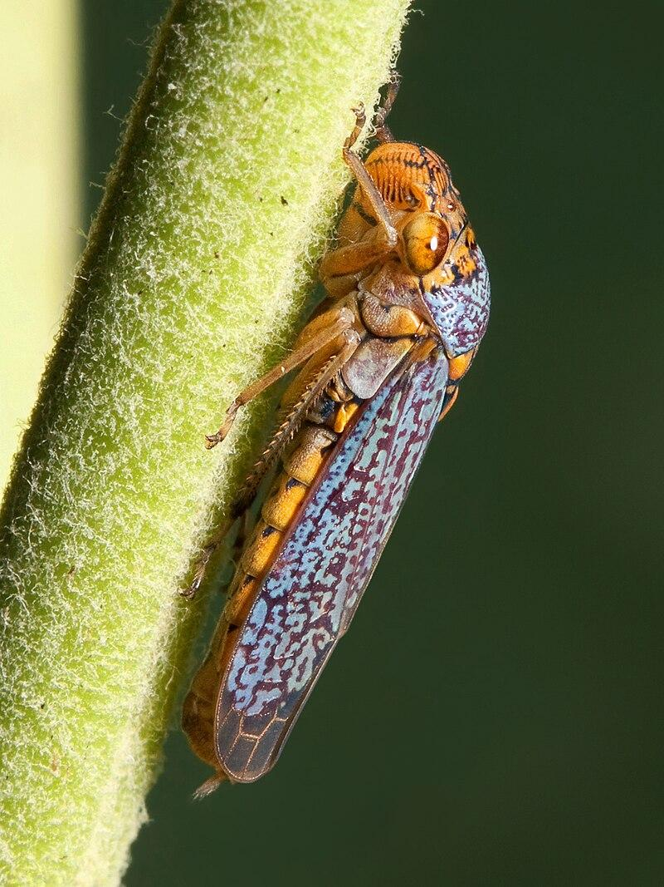
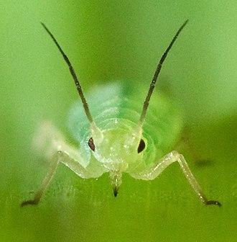
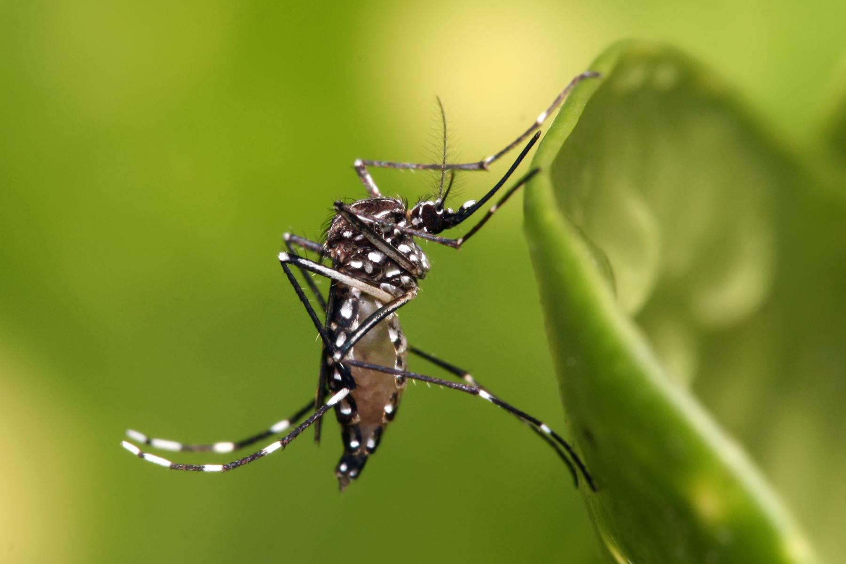
Aphid
Sharpshooter
Mosquito
Notes:
Motivation [ Zach ]
USDA, Auburn
Emphasize importance of this tool to researchers
EPG background
WinDaq
Nothing made for mosquitos
Machine learning methods in EPG research are not particularly modern
Script:
Feeding the world (globe) is difficult and it is being made more difficult by climate change. Among many challenges, one of the biggest threats to crop and livestock production in the United States is invasive pests whose ranges are constantly expanding northward as our world warms. Among these pests are aphids (picture), sharpshooters (picture), and mosquitoes (picture), all of which feed on their unadapted hosts and pass along diseases that decimate (dead crops?) yields in the process. Clearly, this is bad. It concerns not just our sponsors at the US Department of Agriculture and University of Auburn, but the entire agricultural industry and by extension us, who rely on it for food everyday. To combat these pests, we need to understand how they feed to create targeted responses. So how do we do that? These pests (back to bugs), and particularly their mouths, are small. The ones we are concerned about use stylets (graphic) to puncture their hosts, hiding the feeding process from our view. One answer, the focus of our project, is called electropenetography or EPG (text on screen) for short. It is a difficult process that involves gluing thin gold wires onto insects under a microscope (picture), placing them on a host, and putting them into a circuit like so, where a very small amount of current flows through the insect, into the host plant, and back to the power source (picture). As the insect goes through the different stages of its feeding, the voltage across the insect, which is essentially a resistor, changes as it punctures cells walls, blood vessels, salivates, and otherwise feeds on its host. Plotting this voltage against time, entomologists create an EPG recording which looks something like this (picture). Their next step is to segment this graph based on what stage of feeding the insect was in. As an example, take this EPG recording of a mosquito feeding on a human hand and its corresponding segmentation. It’s not important to understand exactly what’s happening, but to give some context about what information can be extracted, we know that this point here (circle on EPG recording) is when the mosquito first punctured the host’s skin. Here is where it began ingesting blood (circle), and here is where it removed its stylet (circle) and flew away. Among many uses of this is giving us insight into how a pesticide does or does not work against a novel pest. Of course, we need labelled data to do this analysis, a process that is incredibly time consuming for our sponsors and lacks purpose-made software, making it difficult to run large-scale experiments. The software they currently use (picture), can hardly be called modern. The limited algorithms that exist for automatically labeling recordings are species-specific (largely made for aphids) and do not extend well to new species. Additionally, they do not take advantage of the computation power and machine learning methods available today. Finally, they are difficult for entomologists to use. Modernizing this labor-intensive task of labeling EPG recordings is the task of our clinic project.

Slide 5
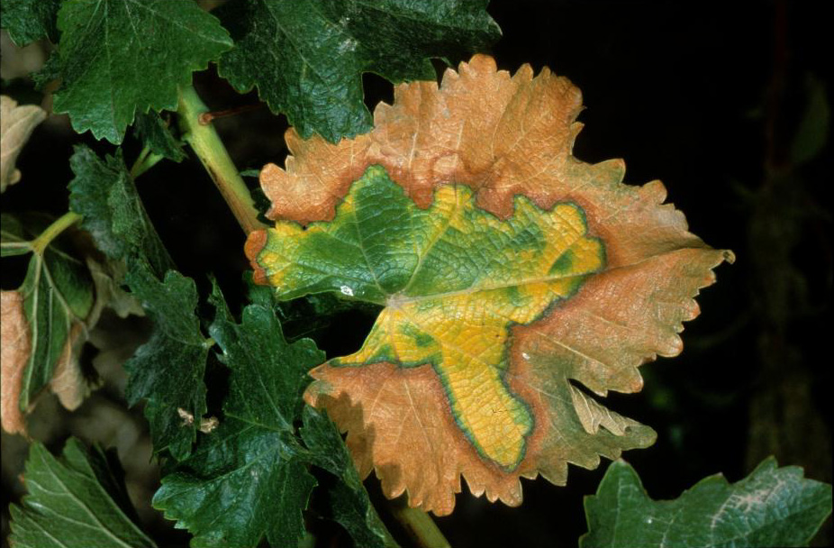
Pierce’s Disease caused by Sharpshooters
(University of California)
Notes:
Motivation [ Zach ]
USDA, Auburn
Emphasize importance of this tool to researchers
EPG background
WinDaq
Nothing made for mosquitos
Machine learning methods in EPG research are not particularly modern
Script:
Feeding the world (globe) is difficult and it is being made more difficult by climate change. Among many challenges, one of the biggest threats to crop and livestock production in the United States is invasive pests whose ranges are constantly expanding northward as our world warms. Among these pests are aphids (picture), sharpshooters (picture), and mosquitoes (picture), all of which feed on their unadapted hosts and pass along diseases that decimate (dead crops?) yields in the process. Clearly, this is bad. It concerns not just our sponsors at the US Department of Agriculture and University of Auburn, but the entire agricultural industry and by extension us, who rely on it for food everyday. To combat these pests, we need to understand how they feed to create targeted responses. So how do we do that? These pests (back to bugs), and particularly their mouths, are small. The ones we are concerned about use stylets (graphic) to puncture their hosts, hiding the feeding process from our view. One answer, the focus of our project, is called electropenetography or EPG (text on screen) for short. It is a difficult process that involves gluing thin gold wires onto insects under a microscope (picture), placing them on a host, and putting them into a circuit like so, where a very small amount of current flows through the insect, into the host plant, and back to the power source (picture). As the insect goes through the different stages of its feeding, the voltage across the insect, which is essentially a resistor, changes as it punctures cells walls, blood vessels, salivates, and otherwise feeds on its host. Plotting this voltage against time, entomologists create an EPG recording which looks something like this (picture). Their next step is to segment this graph based on what stage of feeding the insect was in. As an example, take this EPG recording of a mosquito feeding on a human hand and its corresponding segmentation. It’s not important to understand exactly what’s happening, but to give some context about what information can be extracted, we know that this point here (circle on EPG recording) is when the mosquito first punctured the host’s skin. Here is where it began ingesting blood (circle), and here is where it removed its stylet (circle) and flew away. Among many uses of this is giving us insight into how a pesticide does or does not work against a novel pest. Of course, we need labelled data to do this analysis, a process that is incredibly time consuming for our sponsors and lacks purpose-made software, making it difficult to run large-scale experiments. The software they currently use (picture), can hardly be called modern. The limited algorithms that exist for automatically labeling recordings are species-specific (largely made for aphids) and do not extend well to new species. Additionally, they do not take advantage of the computation power and machine learning methods available today. Finally, they are difficult for entomologists to use. Modernizing this labor-intensive task of labeling EPG recordings is the task of our clinic project.

Slide 6
Aphid
Sharpshooter
Mosquito
Notes:
Motivation [ Zach ]
USDA, Auburn
Emphasize importance of this tool to researchers
EPG background
WinDaq
Nothing made for mosquitos
Machine learning methods in EPG research are not particularly modern
Script:
Feeding the world (globe) is difficult and it is being made more difficult by climate change. Among many challenges, one of the biggest threats to crop and livestock production in the United States is invasive pests whose ranges are constantly expanding northward as our world warms. Among these pests are aphids (picture), sharpshooters (picture), and mosquitoes (picture), all of which feed on their unadapted hosts and pass along diseases that decimate (dead crops?) yields in the process. Clearly, this is bad. It concerns not just our sponsors at the US Department of Agriculture and University of Auburn, but the entire agricultural industry and by extension us, who rely on it for food everyday. To combat these pests, we need to understand how they feed to create targeted responses. So how do we do that? These pests (back to bugs), and particularly their mouths, are small. The ones we are concerned about use stylets (graphic) to puncture their hosts, hiding the feeding process from our view. One answer, the focus of our project, is called electropenetography or EPG (text on screen) for short. It is a difficult process that involves gluing thin gold wires onto insects under a microscope (picture), placing them on a host, and putting them into a circuit like so, where a very small amount of current flows through the insect, into the host plant, and back to the power source (picture). As the insect goes through the different stages of its feeding, the voltage across the insect, which is essentially a resistor, changes as it punctures cells walls, blood vessels, salivates, and otherwise feeds on its host. Plotting this voltage against time, entomologists create an EPG recording which looks something like this (picture). Their next step is to segment this graph based on what stage of feeding the insect was in. As an example, take this EPG recording of a mosquito feeding on a human hand and its corresponding segmentation. It’s not important to understand exactly what’s happening, but to give some context about what information can be extracted, we know that this point here (circle on EPG recording) is when the mosquito first punctured the host’s skin. Here is where it began ingesting blood (circle), and here is where it removed its stylet (circle) and flew away. Among many uses of this is giving us insight into how a pesticide does or does not work against a novel pest. Of course, we need labelled data to do this analysis, a process that is incredibly time consuming for our sponsors and lacks purpose-made software, making it difficult to run large-scale experiments. The software they currently use (picture), can hardly be called modern. The limited algorithms that exist for automatically labeling recordings are species-specific (largely made for aphids) and do not extend well to new species. Additionally, they do not take advantage of the computation power and machine learning methods available today. Finally, they are difficult for entomologists to use. Modernizing this labor-intensive task of labeling EPG recordings is the task of our clinic project.

Slide 7
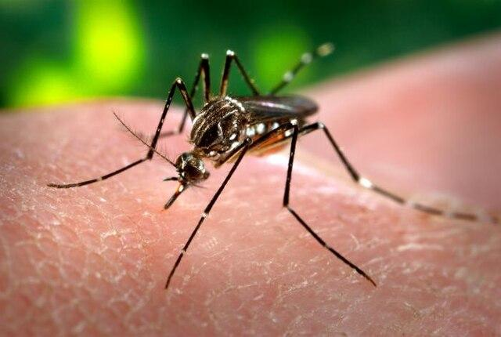
We can’t directly observe what the mouthparts are doing
Notes:
Motivation [ Zach ]
USDA, Auburn
Emphasize importance of this tool to researchers
EPG background
WinDaq
Nothing made for mosquitos
Machine learning methods in EPG research are not particularly modern
Script:
Feeding the world (globe) is difficult and it is being made more difficult by climate change. Among many challenges, one of the biggest threats to crop and livestock production in the United States is invasive pests whose ranges are constantly expanding northward as our world warms. Among these pests are aphids (picture), sharpshooters (picture), and mosquitoes (picture), all of which feed on their unadapted hosts and pass along diseases that decimate (dead crops?) yields in the process. Clearly, this is bad. It concerns not just our sponsors at the US Department of Agriculture and University of Auburn, but the entire agricultural industry and by extension us, who rely on it for food everyday. To combat these pests, we need to understand how they feed to create targeted responses. So how do we do that? These pests (back to bugs), and particularly their mouths, are small. The ones we are concerned about use stylets (graphic) to puncture their hosts, hiding the feeding process from our view. One answer, the focus of our project, is called electropenetography or EPG (text on screen) for short. It is a difficult process that involves gluing thin gold wires onto insects under a microscope (picture), placing them on a host, and putting them into a circuit like so, where a very small amount of current flows through the insect, into the host plant, and back to the power source (picture). As the insect goes through the different stages of its feeding, the voltage across the insect, which is essentially a resistor, changes as it punctures cells walls, blood vessels, salivates, and otherwise feeds on its host. Plotting this voltage against time, entomologists create an EPG recording which looks something like this (picture). Their next step is to segment this graph based on what stage of feeding the insect was in. As an example, take this EPG recording of a mosquito feeding on a human hand and its corresponding segmentation. It’s not important to understand exactly what’s happening, but to give some context about what information can be extracted, we know that this point here (circle on EPG recording) is when the mosquito first punctured the host’s skin. Here is where it began ingesting blood (circle), and here is where it removed its stylet (circle) and flew away. Among many uses of this is giving us insight into how a pesticide does or does not work against a novel pest. Of course, we need labelled data to do this analysis, a process that is incredibly time consuming for our sponsors and lacks purpose-made software, making it difficult to run large-scale experiments. The software they currently use (picture), can hardly be called modern. The limited algorithms that exist for automatically labeling recordings are species-specific (largely made for aphids) and do not extend well to new species. Additionally, they do not take advantage of the computation power and machine learning methods available today. Finally, they are difficult for entomologists to use. Modernizing this labor-intensive task of labeling EPG recordings is the task of our clinic project.

Slide 8
Electropenetrography
(EPG)
Notes:
Motivation [ Zach ]
USDA, Auburn
Emphasize importance of this tool to researchers
EPG background
WinDaq
Nothing made for mosquitos
Machine learning methods in EPG research are not particularly modern
Script:
Feeding the world (globe) is difficult and it is being made more difficult by climate change. Among many challenges, one of the biggest threats to crop and livestock production in the United States is invasive pests whose ranges are constantly expanding northward as our world warms. Among these pests are aphids (picture), sharpshooters (picture), and mosquitoes (picture), all of which feed on their unadapted hosts and pass along diseases that decimate (dead crops?) yields in the process. Clearly, this is bad. It concerns not just our sponsors at the US Department of Agriculture and University of Auburn, but the entire agricultural industry and by extension us, who rely on it for food everyday. To combat these pests, we need to understand how they feed to create targeted responses. So how do we do that? These pests (back to bugs), and particularly their mouths, are small. The ones we are concerned about use stylets (graphic) to puncture their hosts, hiding the feeding process from our view. One answer, the focus of our project, is called electropenetography or EPG (text on screen) for short. It is a difficult process that involves gluing thin gold wires onto insects under a microscope (picture), placing them on a host, and putting them into a circuit like so, where a very small amount of current flows through the insect, into the host plant, and back to the power source (picture). As the insect goes through the different stages of its feeding, the voltage across the insect, which is essentially a resistor, changes as it punctures cells walls, blood vessels, salivates, and otherwise feeds on its host. Plotting this voltage against time, entomologists create an EPG recording which looks something like this (picture). Their next step is to segment this graph based on what stage of feeding the insect was in. As an example, take this EPG recording of a mosquito feeding on a human hand and its corresponding segmentation. It’s not important to understand exactly what’s happening, but to give some context about what information can be extracted, we know that this point here (circle on EPG recording) is when the mosquito first punctured the host’s skin. Here is where it began ingesting blood (circle), and here is where it removed its stylet (circle) and flew away. Among many uses of this is giving us insight into how a pesticide does or does not work against a novel pest. Of course, we need labelled data to do this analysis, a process that is incredibly time consuming for our sponsors and lacks purpose-made software, making it difficult to run large-scale experiments. The software they currently use (picture), can hardly be called modern. The limited algorithms that exist for automatically labeling recordings are species-specific (largely made for aphids) and do not extend well to new species. Additionally, they do not take advantage of the computation power and machine learning methods available today. Finally, they are difficult for entomologists to use. Modernizing this labor-intensive task of labeling EPG recordings is the task of our clinic project.

Slide 9
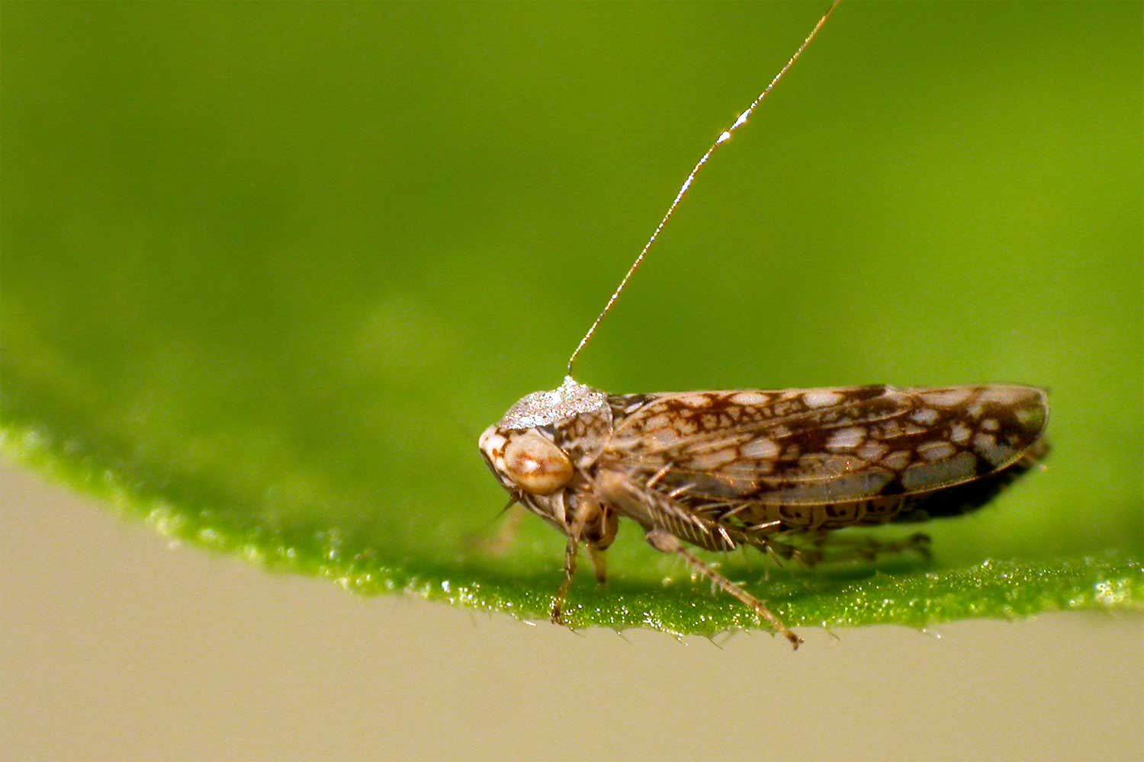
Leafhopper ready for EPG
Notes:
Motivation [ Zach ]
USDA, Auburn
Emphasize importance of this tool to researchers
EPG background
WinDaq
Nothing made for mosquitos
Machine learning methods in EPG research are not particularly modern
Script:
Feeding the world (globe) is difficult and it is being made more difficult by climate change. Among many challenges, one of the biggest threats to crop and livestock production in the United States is invasive pests whose ranges are constantly expanding northward as our world warms. Among these pests are aphids (picture), sharpshooters (picture), and mosquitoes (picture), all of which feed on their unadapted hosts and pass along diseases that decimate (dead crops?) yields in the process. Clearly, this is bad. It concerns not just our sponsors at the US Department of Agriculture and University of Auburn, but the entire agricultural industry and by extension us, who rely on it for food everyday. To combat these pests, we need to understand how they feed to create targeted responses. So how do we do that? These pests (back to bugs), and particularly their mouths, are small. The ones we are concerned about use stylets (graphic) to puncture their hosts, hiding the feeding process from our view. One answer, the focus of our project, is called electropenetography or EPG (text on screen) for short. It is a difficult process that involves gluing thin gold wires onto insects under a microscope (picture), placing them on a host, and putting them into a circuit like so, where a very small amount of current flows through the insect, into the host plant, and back to the power source (picture). As the insect goes through the different stages of its feeding, the voltage across the insect, which is essentially a resistor, changes as it punctures cells walls, blood vessels, salivates, and otherwise feeds on its host. Plotting this voltage against time, entomologists create an EPG recording which looks something like this (picture). Their next step is to segment this graph based on what stage of feeding the insect was in. As an example, take this EPG recording of a mosquito feeding on a human hand and its corresponding segmentation. It’s not important to understand exactly what’s happening, but to give some context about what information can be extracted, we know that this point here (circle on EPG recording) is when the mosquito first punctured the host’s skin. Here is where it began ingesting blood (circle), and here is where it removed its stylet (circle) and flew away. Among many uses of this is giving us insight into how a pesticide does or does not work against a novel pest. Of course, we need labelled data to do this analysis, a process that is incredibly time consuming for our sponsors and lacks purpose-made software, making it difficult to run large-scale experiments. The software they currently use (picture), can hardly be called modern. The limited algorithms that exist for automatically labeling recordings are species-specific (largely made for aphids) and do not extend well to new species. Additionally, they do not take advantage of the computation power and machine learning methods available today. Finally, they are difficult for entomologists to use. Modernizing this labor-intensive task of labeling EPG recordings is the aim of our clinic project.

Slide 10
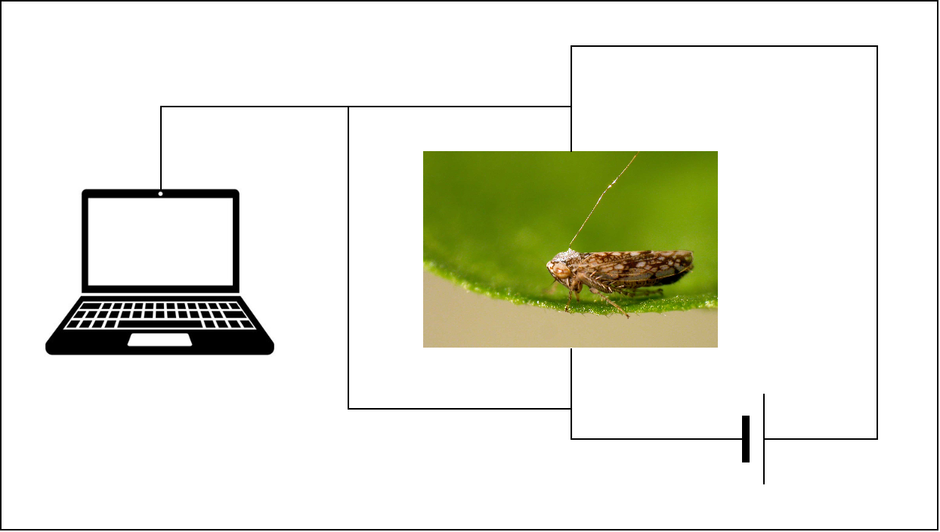
EPG Circuit
Notes:
Motivation [ Zach ]
USDA, Auburn
Emphasize importance of this tool to researchers
EPG background
WinDaq
Nothing made for mosquitos
Machine learning methods in EPG research are not particularly modern
Script:
Feeding the world (globe) is difficult and it is being made more difficult by climate change. Among many challenges, one of the biggest threats to crop and livestock production in the United States is invasive pests whose ranges are constantly expanding northward as our world warms. Among these pests are aphids (picture), sharpshooters (picture), and mosquitoes (picture), all of which feed on their unadapted hosts and pass along diseases that decimate (dead crops?) yields in the process. Clearly, this is bad. It concerns not just our sponsors at the US Department of Agriculture and University of Auburn, but the entire agricultural industry and by extension us, who rely on it for food everyday. To combat these pests, we need to understand how they feed to create targeted responses. So how do we do that? These pests (back to bugs), and particularly their mouths, are small. The ones we are concerned about use stylets (graphic) to puncture their hosts, hiding the feeding process from our view. One answer, the focus of our project, is called electropenetography or EPG (text on screen) for short. It is a difficult process that involves gluing thin gold wires onto insects under a microscope (picture), placing them on a host, and putting them into a circuit like so, where a very small amount of current flows through the insect, into the host plant, and back to the power source (picture). As the insect goes through the different stages of its feeding, the voltage across the insect, which is essentially a resistor, changes as it punctures cells walls, blood vessels, salivates, and otherwise feeds on its host. Plotting this voltage against time, entomologists create an EPG recording which looks something like this (picture). Their next step is to segment this graph based on what stage of feeding the insect was in. As an example, take this EPG recording of a mosquito feeding on a human hand and its corresponding segmentation. It’s not important to understand exactly what’s happening, but to give some context about what information can be extracted, we know that this point here (circle on EPG recording) is when the mosquito first punctured the host’s skin. Here is where it began ingesting blood (circle), and here is where it removed its stylet (circle) and flew away. Among many uses of this is giving us insight into how a pesticide does or does not work against a novel pest. Of course, we need labelled data to do this analysis, a process that is incredibly time consuming for our sponsors and lacks purpose-made software, making it difficult to run large-scale experiments. The software they currently use (picture), can hardly be called modern. The limited algorithms that exist for automatically labeling recordings are species-specific (largely made for aphids) and do not extend well to new species. Additionally, they do not take advantage of the computation power and machine learning methods available today. Finally, they are difficult for entomologists to use. Modernizing this labor-intensive task of labeling EPG recordings is the aim of our clinic project.

Slide 11
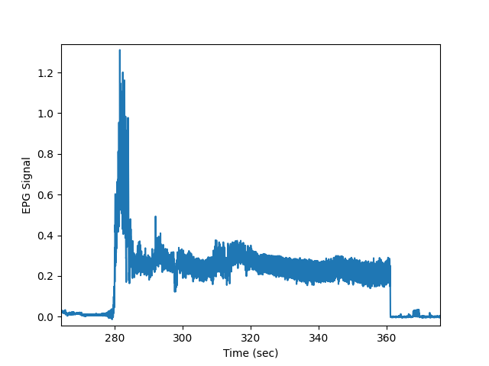
EPG Recording
Notes:
Motivation [ Zach ]
USDA, Auburn
Emphasize importance of this tool to researchers
EPG background
WinDaq
Nothing made for mosquitos
Machine learning methods in EPG research are not particularly modern
Script:
Feeding the world (globe) is difficult and it is being made more difficult by climate change. Among many challenges, one of the biggest threats to crop and livestock production in the United States is invasive pests whose ranges are constantly expanding northward as our world warms. Among these pests are aphids (picture), sharpshooters (picture), and mosquitoes (picture), all of which feed on their unadapted hosts and pass along diseases that decimate (dead crops?) yields in the process. Clearly, this is bad. It concerns not just our sponsors at the US Department of Agriculture and University of Auburn, but the entire agricultural industry and by extension us, who rely on it for food everyday. To combat these pests, we need to understand how they feed to create targeted responses. So how do we do that? These pests (back to bugs), and particularly their mouths, are small. The ones we are concerned about use stylets (graphic) to puncture their hosts, hiding the feeding process from our view. One answer, the focus of our project, is called electropenetography or EPG (text on screen) for short. It is a difficult process that involves gluing thin gold wires onto insects under a microscope (picture), placing them on a host, and putting them into a circuit like so, where a very small amount of current flows through the insect, into the host plant, and back to the power source (picture). As the insect goes through the different stages of its feeding, the voltage across the insect, which is essentially a resistor, changes as it punctures cells walls, blood vessels, salivates, and otherwise feeds on its host. Plotting this voltage against time, entomologists create an EPG recording which looks something like this (picture). Their next step is to segment this graph based on what stage of feeding the insect was in. As an example, take this EPG recording of a mosquito feeding on a human hand and its corresponding segmentation. It’s not important to understand exactly what’s happening, but to give some context about what information can be extracted, we know that this point here (circle on EPG recording) is when the mosquito first punctured the host’s skin. Here is where it began ingesting blood (circle), and here is where it removed its stylet (circle) and flew away. Among many uses of this is giving us insight into how a pesticide does or does not work against a novel pest. Of course, we need labelled data to do this analysis, a process that is incredibly time consuming for our sponsors and lacks purpose-made software, making it difficult to run large-scale experiments. The software they currently use (picture), can hardly be called modern. The limited algorithms that exist for automatically labeling recordings are species-specific (largely made for aphids) and do not extend well to new species. Additionally, they do not take advantage of the computation power and machine learning methods available today. Finally, they are difficult for entomologists to use. Modernizing this labor-intensive task of labeling EPG recordings is the aim of our clinic project.

Slide 12
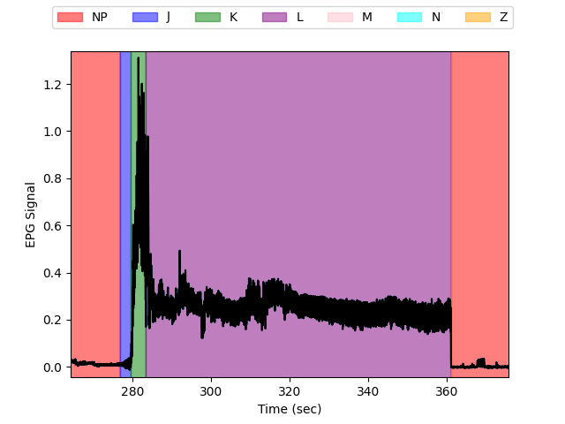
EPG Recording
Notes:
Motivation [ Zach ]
USDA, Auburn
Emphasize importance of this tool to researchers
EPG background
WinDaq
Nothing made for mosquitos
Machine learning methods in EPG research are not particularly modern
Script:
Feeding the world (globe) is difficult and it is being made more difficult by climate change. Among many challenges, one of the biggest threats to crop and livestock production in the United States is invasive pests whose ranges are constantly expanding northward as our world warms. Among these pests are aphids (picture), sharpshooters (picture), and mosquitoes (picture), all of which feed on their unadapted hosts and pass along diseases that decimate (dead crops?) yields in the process. Clearly, this is bad. It concerns not just our sponsors at the US Department of Agriculture and University of Auburn, but the entire agricultural industry and by extension us, who rely on it for food everyday. To combat these pests, we need to understand how they feed to create targeted responses. So how do we do that? These pests (back to bugs), and particularly their mouths, are small. The ones we are concerned about use stylets (graphic) to puncture their hosts, hiding the feeding process from our view. One answer, the focus of our project, is called electropenetography or EPG (text on screen) for short. It is a difficult process that involves gluing thin gold wires onto insects under a microscope (picture), placing them on a host, and putting them into a circuit like so, where a very small amount of current flows through the insect, into the host plant, and back to the power source (picture). As the insect goes through the different stages of its feeding, the voltage across the insect, which is essentially a resistor, changes as it punctures cells walls, blood vessels, salivates, and otherwise feeds on its host. Plotting this voltage against time, entomologists create an EPG recording which looks something like this (picture). Their next step is to segment this graph based on what stage of feeding the insect was in. As an example, take this EPG recording of a mosquito feeding on a human hand and its corresponding segmentation. It’s not important to understand exactly what’s happening, but to give some context about what information can be extracted, we know that this point here (circle on EPG recording) is when the mosquito first punctured the host’s skin. Here is where it began ingesting blood (circle), and here is where it removed its stylet (circle) and flew away. Among many uses of this is giving us insight into how a pesticide does or does not work against a novel pest. Of course, we need labelled data to do this analysis, a process that is incredibly time consuming for our sponsors and lacks purpose-made software, making it difficult to run large-scale experiments. The software they currently use (picture), can hardly be called modern. The limited algorithms that exist for automatically labeling recordings are species-specific (largely made for aphids) and do not extend well to new species. Additionally, they do not take advantage of the computation power and machine learning methods available today. Finally, they are difficult for entomologists to use. Modernizing this labor-intensive task of labeling EPG recordings is the aim of our clinic project.

Slide 13
EPG Recording
Notes:
Motivation [ Zach ]
USDA, Auburn
Emphasize importance of this tool to researchers
EPG background
WinDaq
Nothing made for mosquitos
Machine learning methods in EPG research are not particularly modern
Script:
Feeding the world (globe) is difficult and it is being made more difficult by climate change. Among many challenges, one of the biggest threats to crop and livestock production in the United States is invasive pests whose ranges are constantly expanding northward as our world warms. Among these pests are aphids (picture), sharpshooters (picture), and mosquitoes (picture), all of which feed on their unadapted hosts and pass along diseases that decimate (dead crops?) yields in the process. Clearly, this is bad. It concerns not just our sponsors at the US Department of Agriculture and University of Auburn, but the entire agricultural industry and by extension us, who rely on it for food everyday. To combat these pests, we need to understand how they feed to create targeted responses. So how do we do that? These pests (back to bugs), and particularly their mouths, are small. The ones we are concerned about use stylets (graphic) to puncture their hosts, hiding the feeding process from our view. One answer, the focus of our project, is called electropenetography or EPG (text on screen) for short. It is a difficult process that involves gluing thin gold wires onto insects under a microscope (picture), placing them on a host, and putting them into a circuit like so, where a very small amount of current flows through the insect, into the host plant, and back to the power source (picture). As the insect goes through the different stages of its feeding, the voltage across the insect, which is essentially a resistor, changes as it punctures cells walls, blood vessels, salivates, and otherwise feeds on its host. Plotting this voltage against time, entomologists create an EPG recording which looks something like this (picture). Their next step is to segment this graph based on what stage of feeding the insect was in. As an example, take this EPG recording of a mosquito feeding on a human hand and its corresponding segmentation. It’s not important to understand exactly what’s happening, but to give some context about what information can be extracted, we know that this point here (circle on EPG recording) is when the mosquito first punctured the host’s skin. Here is where it began ingesting blood (circle), and here is where it removed its stylet (circle) and flew away. Among many uses of this is giving us insight into how a pesticide does or does not work against a novel pest. Of course, we need labelled data to do this analysis, a process that is incredibly time consuming for our sponsors and lacks purpose-made software, making it difficult to run large-scale experiments. The software they currently use (picture), can hardly be called modern. The limited algorithms that exist for automatically labeling recordings are species-specific (largely made for aphids) and do not extend well to new species. Additionally, they do not take advantage of the computation power and machine learning methods available today. Finally, they are difficult for entomologists to use. Modernizing this labor-intensive task of labeling EPG recordings is the aim of our clinic project.

Slide 14
EPG Recording
Notes:
Motivation [ Zach ]
USDA, Auburn
Emphasize importance of this tool to researchers
EPG background
WinDaq
Nothing made for mosquitos
Machine learning methods in EPG research are not particularly modern
Script:
Feeding the world (globe) is difficult and it is being made more difficult by climate change. Among many challenges, one of the biggest threats to crop and livestock production in the United States is invasive pests whose ranges are constantly expanding northward as our world warms. Among these pests are aphids (picture), sharpshooters (picture), and mosquitoes (picture), all of which feed on their unadapted hosts and pass along diseases that decimate (dead crops?) yields in the process. Clearly, this is bad. It concerns not just our sponsors at the US Department of Agriculture and University of Auburn, but the entire agricultural industry and by extension us, who rely on it for food everyday. To combat these pests, we need to understand how they feed to create targeted responses. So how do we do that? These pests (back to bugs), and particularly their mouths, are small. The ones we are concerned about use stylets (graphic) to puncture their hosts, hiding the feeding process from our view. One answer, the focus of our project, is called electropenetography or EPG (text on screen) for short. It is a difficult process that involves gluing thin gold wires onto insects under a microscope (picture), placing them on a host, and putting them into a circuit like so, where a very small amount of current flows through the insect, into the host plant, and back to the power source (picture). As the insect goes through the different stages of its feeding, the voltage across the insect, which is essentially a resistor, changes as it punctures cells walls, blood vessels, salivates, and otherwise feeds on its host. Plotting this voltage against time, entomologists create an EPG recording which looks something like this (picture). Their next step is to segment this graph based on what stage of feeding the insect was in. As an example, take this EPG recording of a mosquito feeding on a human hand and its corresponding segmentation. It’s not important to understand exactly what’s happening, but to give some context about what information can be extracted, we know that this point here (circle on EPG recording) is when the mosquito first punctured the host’s skin. Here is where it began ingesting blood (circle), and here is where it removed its stylet (circle) and flew away. Among many uses of this is giving us insight into how a pesticide does or does not work against a novel pest. Of course, we need labelled data to do this analysis, a process that is incredibly time consuming for our sponsors and lacks purpose-made software, making it difficult to run large-scale experiments. The software they currently use (picture), can hardly be called modern. The limited algorithms that exist for automatically labeling recordings are species-specific (largely made for aphids) and do not extend well to new species. Additionally, they do not take advantage of the computation power and machine learning methods available today. Finally, they are difficult for entomologists to use. Modernizing this labor-intensive task of labeling EPG recordings is the aim of our clinic project.

Slide 15
EPG Recording
Notes:
Motivation [ Zach ]
USDA, Auburn
Emphasize importance of this tool to researchers
EPG background
WinDaq
Nothing made for mosquitos
Machine learning methods in EPG research are not particularly modern
Script:
Feeding the world (globe) is difficult and it is being made more difficult by climate change. Among many challenges, one of the biggest threats to crop and livestock production in the United States is invasive pests whose ranges are constantly expanding northward as our world warms. Among these pests are aphids (picture), sharpshooters (picture), and mosquitoes (picture), all of which feed on their unadapted hosts and pass along diseases that decimate (dead crops?) yields in the process. Clearly, this is bad. It concerns not just our sponsors at the US Department of Agriculture and University of Auburn, but the entire agricultural industry and by extension us, who rely on it for food everyday. To combat these pests, we need to understand how they feed to create targeted responses. So how do we do that? These pests (back to bugs), and particularly their mouths, are small. The ones we are concerned about use stylets (graphic) to puncture their hosts, hiding the feeding process from our view. One answer, the focus of our project, is called electropenetography or EPG (text on screen) for short. It is a difficult process that involves gluing thin gold wires onto insects under a microscope (picture), placing them on a host, and putting them into a circuit like so, where a very small amount of current flows through the insect, into the host plant, and back to the power source (picture). As the insect goes through the different stages of its feeding, the voltage across the insect, which is essentially a resistor, changes as it punctures cells walls, blood vessels, salivates, and otherwise feeds on its host. Plotting this voltage against time, entomologists create an EPG recording which looks something like this (picture). Their next step is to segment this graph based on what stage of feeding the insect was in. As an example, take this EPG recording of a mosquito feeding on a human hand and its corresponding segmentation. It’s not important to understand exactly what’s happening, but to give some context about what information can be extracted, we know that this point here (circle on EPG recording) is when the mosquito first punctured the host’s skin. Here is where it began ingesting blood (circle), and here is where it removed its stylet (circle) and flew away. Among many uses of this is giving us insight into how a pesticide does or does not work against a novel pest. Of course, we need labelled data to do this analysis, a process that is incredibly time consuming for our sponsors and lacks purpose-made software, making it difficult to run large-scale experiments. The software they currently use (picture), can hardly be called modern. The limited algorithms that exist for automatically labeling recordings are species-specific (largely made for aphids) and do not extend well to new species. Additionally, they do not take advantage of the computation power and machine learning methods available today. Finally, they are difficult for entomologists to use. Modernizing this labor-intensive task of labeling EPG recordings is the aim of our clinic project.

Slide 16
Our task: Automate EPG labelling and make it accessible
Notes:
Motivation [ Zach ]
USDA, Auburn
Emphasize importance of this tool to researchers
EPG background
WinDaq
Nothing made for mosquitos
Machine learning methods in EPG research are not particularly modern
Script:
Feeding the world (globe) is difficult and it is being made more difficult by climate change. Among many challenges, one of the biggest threats to crop and livestock production in the United States is invasive pests whose ranges are constantly expanding northward as our world warms. Among these pests are aphids (picture), sharpshooters (picture), and mosquitoes (picture), all of which feed on their unadapted hosts and pass along diseases that decimate (dead crops?) yields in the process. Clearly, this is bad. It concerns not just our sponsors at the US Department of Agriculture and University of Auburn, but the entire agricultural industry and by extension us, who rely on it for food everyday. To combat these pests, we need to understand how they feed to create targeted responses. So how do we do that? These pests (back to bugs), and particularly their mouths, are small. The ones we are concerned about use stylets (graphic) to puncture their hosts, hiding the feeding process from our view. One answer, the focus of our project, is called electropenetography or EPG (text on screen) for short. It is a difficult process that involves gluing thin gold wires onto insects under a microscope (picture), placing them on a host, and putting them into a circuit like so, where a very small amount of current flows through the insect, into the host plant, and back to the power source (picture). As the insect goes through the different stages of its feeding, the voltage across the insect, which is essentially a resistor, changes as it punctures cells walls, blood vessels, salivates, and otherwise feeds on its host. Plotting this voltage against time, entomologists create an EPG recording which looks something like this (picture). Their next step is to segment this graph based on what stage of feeding the insect was in. As an example, take this EPG recording of a mosquito feeding on a human hand and its corresponding segmentation. It’s not important to understand exactly what’s happening, but to give some context about what information can be extracted, we know that this point here (circle on EPG recording) is when the mosquito first punctured the host’s skin. Here is where it began ingesting blood (circle), and here is where it removed its stylet (circle) and flew away. Among many uses of this is giving us insight into how a pesticide does or does not work against a novel pest. Of course, we need labelled data to do this analysis, a process that is incredibly time consuming for our sponsors and lacks purpose-made software, making it difficult to run large-scale experiments. The software they currently use (picture), can hardly be called modern. The limited algorithms that exist for automatically labeling recordings are species-specific (largely made for aphids) and do not extend well to new species. Additionally, they do not take advantage of the computation power and machine learning methods available today. Finally, and perhaps their biggest drawback from a technical perspective, they are difficult for entomologists to use. Modernize labeling EPG recordings is the aim of our clinic project.

Slide 17
Deliverables
Train predictive ML models for waveform segmentation
Present it with an accessible user interface
Explore approaches to automated EPG labeling
Accurately label EPG recordings
Integrate seamlessly with GUI
Simple visualization of data
User oversight of the automated labeling
Tools for manual labeling
Notes:
To achieve this, we focused on four key objectives:
Define Performance Metrics – We needed to determine how to measure the effectiveness of our model and ensure it was genuinely useful for entomologists.
Develop the Model – Our goal was to train a predictive model that could recognize different waveform types in EPG data.
Develop an Interface – We needed a tool that would allow researchers to upload their data, view the waveforms, and receive labeled files.
Expand Tool for Future Use – To make this tool more broadly applicable, we ensured that researchers could retrain the model for different insect species.
Our product is defined by two separate systems that work together: The machine learning model (backend) and the user interface. For the machine learning, the criteria is straightforward: Prototype and create ML models, using different paradigms of machine learning for classification, that automatically label EPG data with a high degree of accuracy. Beyond this, it shall integrate seamlessly with the accompanying GUI, such that a user does not have to think on how to apply it (no command line should be necessary).
The success criteria of the GUI is to present the toolset (machine learning integration) in a way that is simple to use. Furthermore, it shall visualize the data itself in a way that is clear. Finally, it shall present the tools to manually edit the waveform labeling, if necessary, in an understandable manner.
In short, if it provides researchers with the right, well-made tools in a way that is intuitive to use, we have achieved product success. This is the core principle behind our design process.

Slide 18
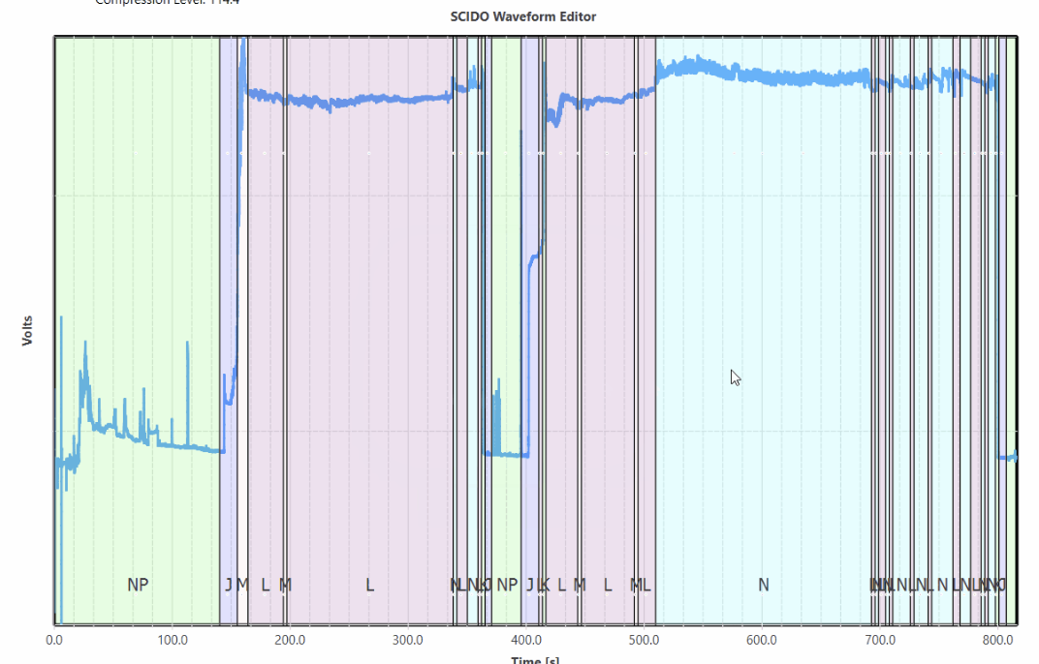
Why ML?
Labeling is a tedious process for humans
For automated recognition, we need:
Consistency
Speed
Makes it perfect for a ML model!
Notes:
The machine learning model was the second important ingredient for our product. The short story is that labeling is a tedious process prone to human error, yet because it isn’t deterministic either, it cannot be easily automated with traditional algorithms. But when you have a bunch of labeled data that corresponds to somewhat discrete states, which is the case for our mosquitoes, it is perfect for a machine learning algorithm. It could be trained on the already labeled data, and then replace humans in the labeling process. This would:
Automate waveform recognition – Rather than requiring entomologists to manually annotate waveforms, our model classifies them automatically, saving time and money.
Improve consistency – Human annotation can be subjective and inconsistent. A trained model ensures uniform labeling across datasets, as it is trained on pre-labeled and reviewed datasets.
Additionally, we benchmarked the model’s performance so our liaisons could use this information in a research paper.

Slide 19
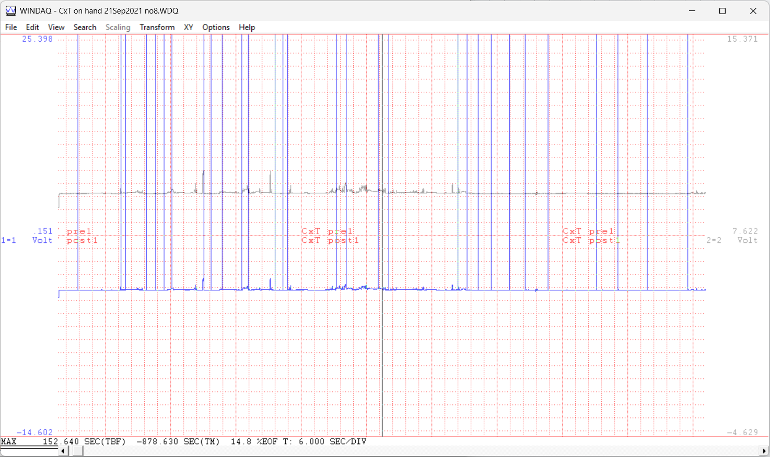
Why do they need a GUI?
Windaq is inefficient and cumbersome
Doesn’t work with ML
Not extendable
Can’t plug models in
Notes:
The new GUI was a critical part of our project. Thus far researchers have used Windaq, which is an extremely powerful and flexible software, but that comes with shortcomings for our purposes. For example, it was deemed insufficient when integrating with ML models. Furthermore, it was deemed cumbersome and difficult to work with, especially for new researchers, and so a more dedicated, in-house and modernized GUI is beneficial to our broader mission.

Slide 20


Workflow
Visualization (data-to-user)
Labeled EPG data in time series
Color-coded regions highlighted
Overall modernized experience compared to Windaq
Characterization (user-to-data)
Apply the ML model to data
Adjust, delete, modify labels
Characterization without alterations to dataset
Notes:
The GUI serves two purposes: Visualization, or data-to-user, and characterization, user-to-data. The visualization is pretty straightforward: The GUI application simply loads and visualizes the waveform data, labeled or unlabeled, to the user in a way similar to how it’s presented in windaq. This part therefore provides a modernized experience to Windaq, as it’s more responsive and sleeker. The characterization is where the real power lies: It gives the user the underlying machine learning model to the waveforms and thus automatically label them. Aside from that, there are also options to add, delete and modify labels, as well as introduce completely new possible labels if necessary. It essentially allows the user to characterize the data, though of course without making any to the data itself.
Overall, the GUI provides a more flexible and modern interface to the data, both in its presentation to the user, as well as how the user is able to work with the data. We will see details on exactly how later.

Slide 21
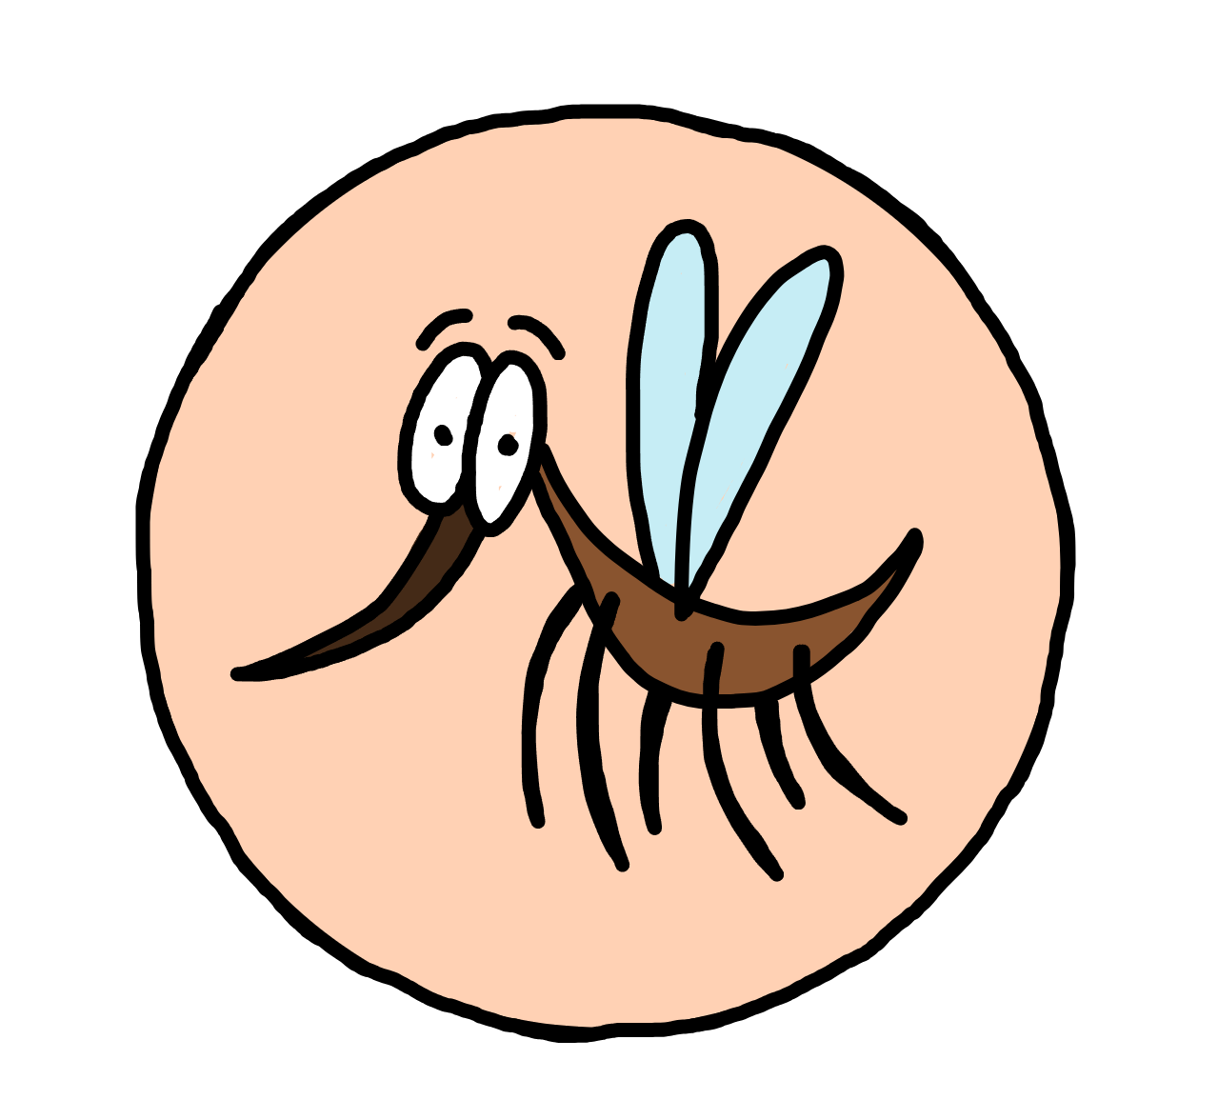
The Software
Supervised
Classification of
Insect
Data and
Observations
SCIDO
Notes:
Our solution to these goals is called SCIDO. I’m going to show you some examples of its use, so you can see its capabilities and get an idea of how streamlined this software is compared to WINDAQ.

Slide 22
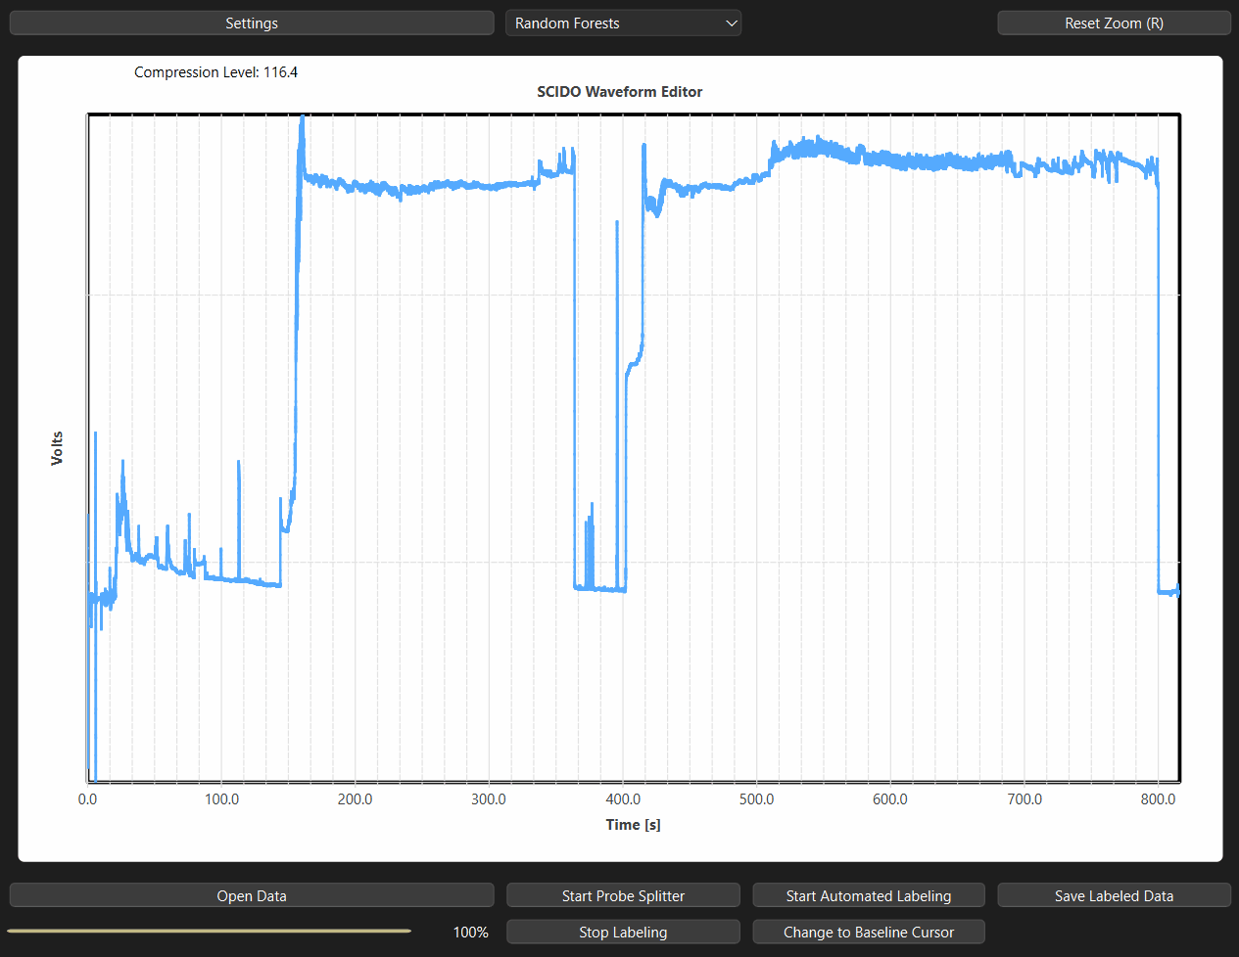
Opening Files
Notes:
This is our software, we’re opening up an unlabeled waveform. This is the same situation that we were in on that last slide.

Slide 23
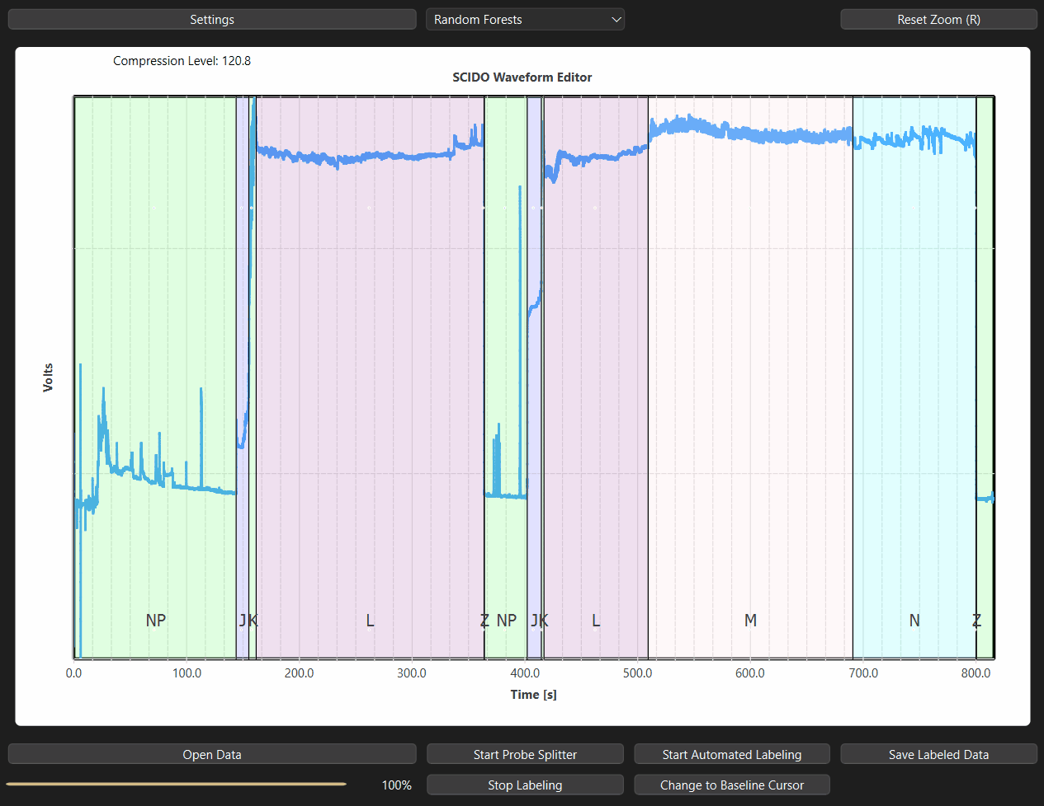
Probe Splitting
Notes:
What we want to do next is start the labeling process. First, we need to define individual probes. The probes here are instances of a mosquito inserting its mouthpart, doing its business, then removing its mouthpart. Here we have two of those, which you can see in those two raised volt plateaus.
So this image is showing the automatic probe splitter. It puts those NP/P labels up (non-probe/probe) and then you can adjust those however you need to. If you want less cushion before and after the probe, or if the probe splitter gets something wrong, you can just slide those transition lines over.

Slide 24
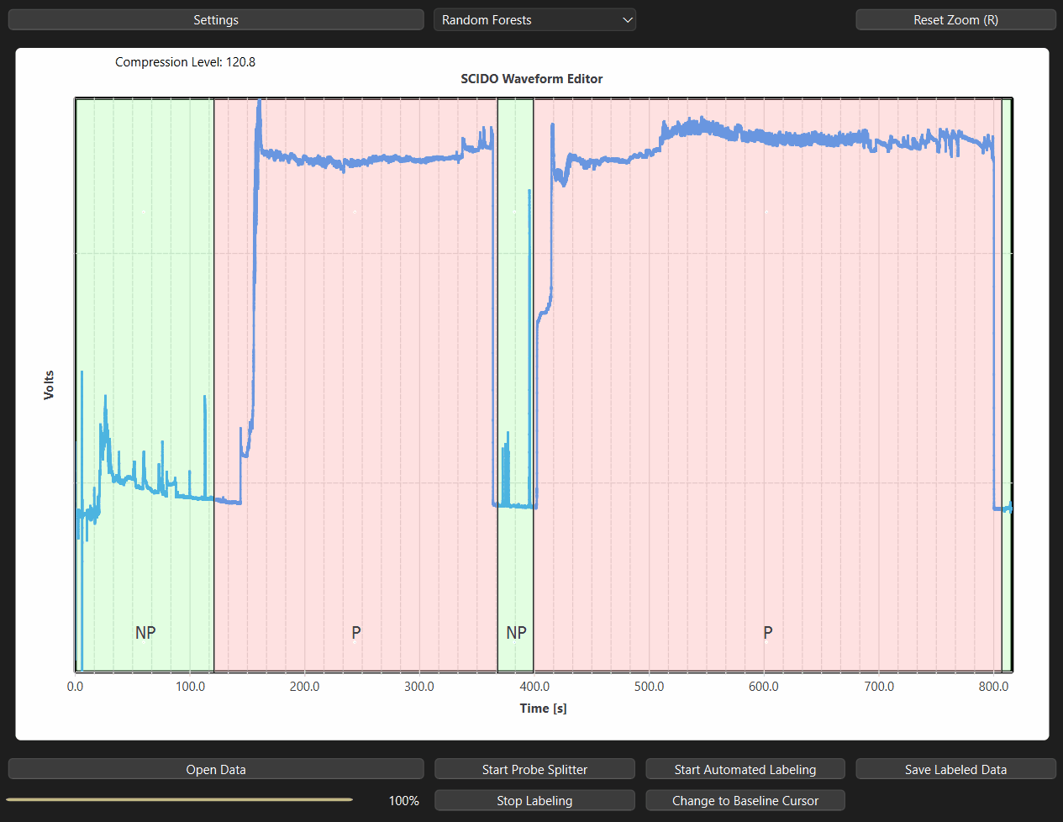
ML Labeling
Notes:
Then, we can start the actual labeler. It will show the transitions and labels just like the probe splitter. We can do a few things here. We can delete transitions. We can move transitions. We can add transitions. And we can change labels. This is all built to make human correction of the automated labeler as easy and smooth as possible.

Slide 25
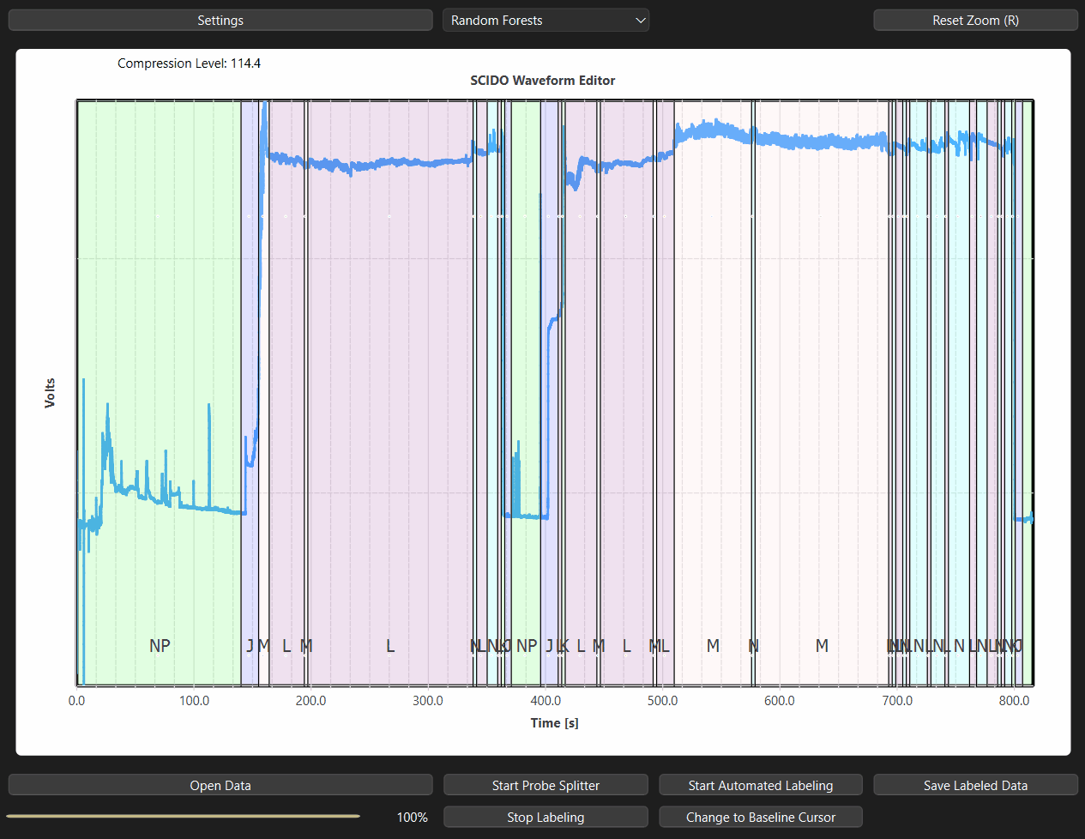
Viewing & Editing
Notes:
There are also a lot of visual settings we can change from within the software: we can change label colors, waveform color, gridline spacing, gridline offset, and visibilities of all the components you see here.

Slide 26
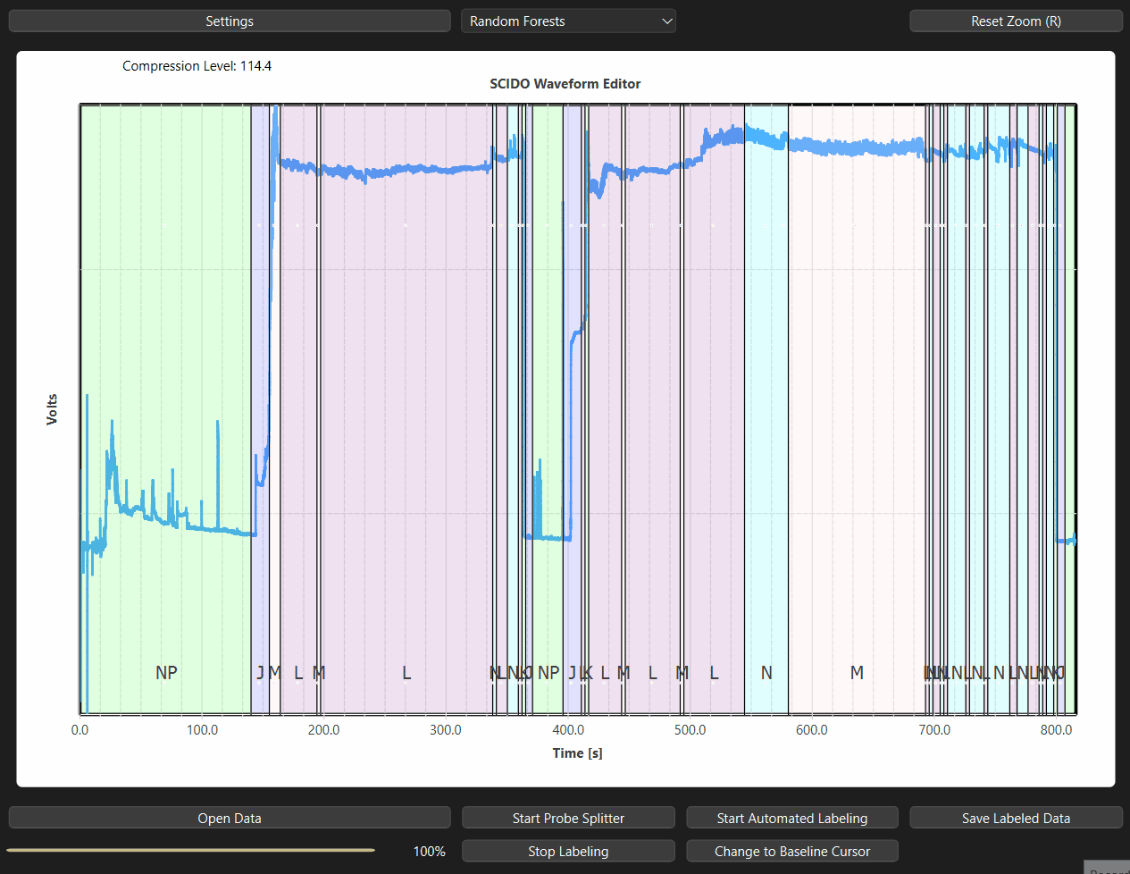
Chart Visuals
Notes:
This is a demonstration of the maneuverability we have in the software. We have horizontal and vertical zooming and scrolling by mouse gesture. In WINDAQ you had to go to a menu and input your zoom level manually. Now, if you need to take a really close look at the waveform to make that transition super accurate, you can just zoom in and back out really nicely.
We are planning to add a tactile scrollbar to the interface, but I think once people get the hang of those gesture movements it makes maneuvering the data really easy and quick.

Slide 27
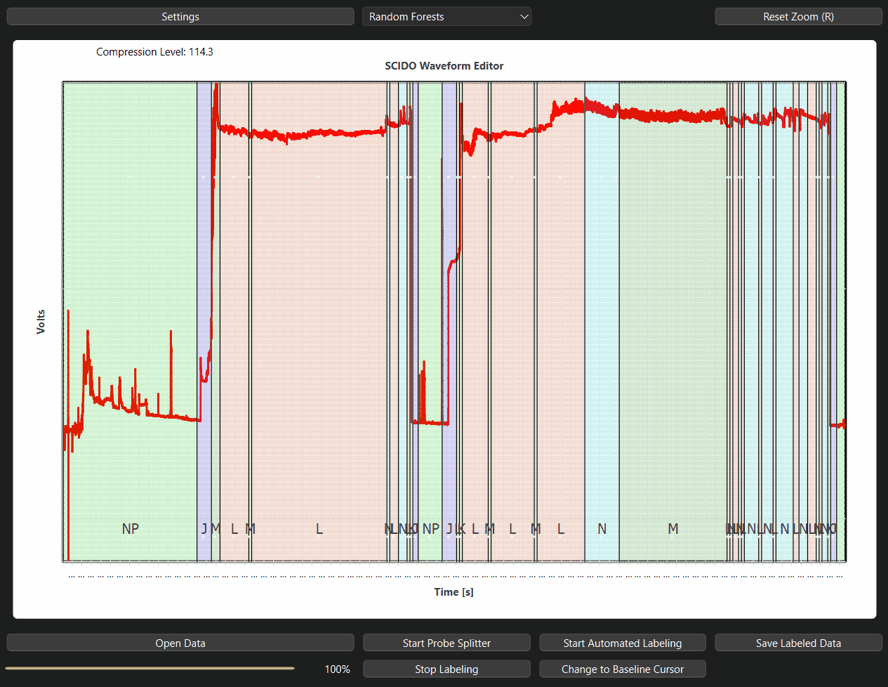
Saving Files
Notes:
Now we’re all done adjusting those labels, so I’m gonna go ahead and save that as a CSV on my computer.
This was a concise version of the actual process that researchers will go through as they use our software for automated labeling.

Slide 28
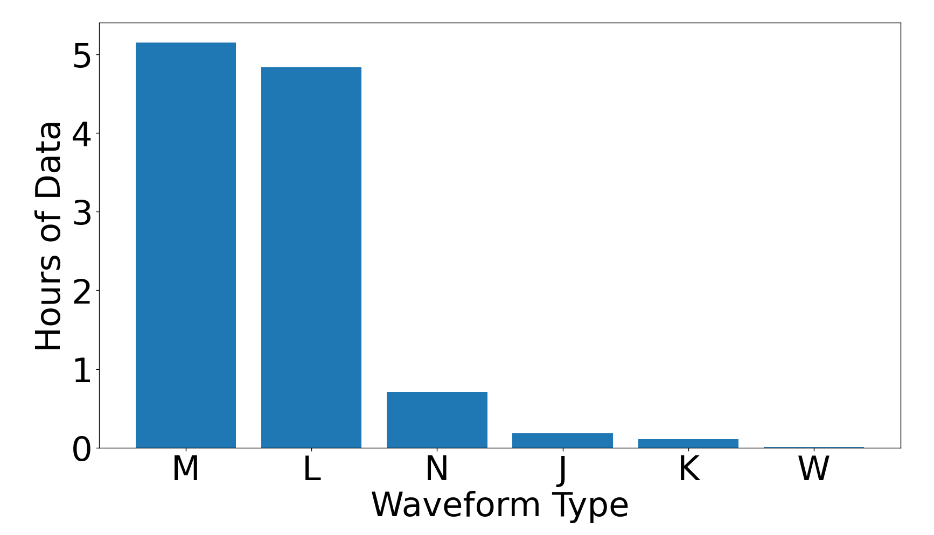
The Data
Annotated EPG recordings
62 files
94 probes
about 11 hours of probing data
Highly imbalanced data
L: searching for a blood vessel
M: sucking blood
W: withdrawal

Slide 29
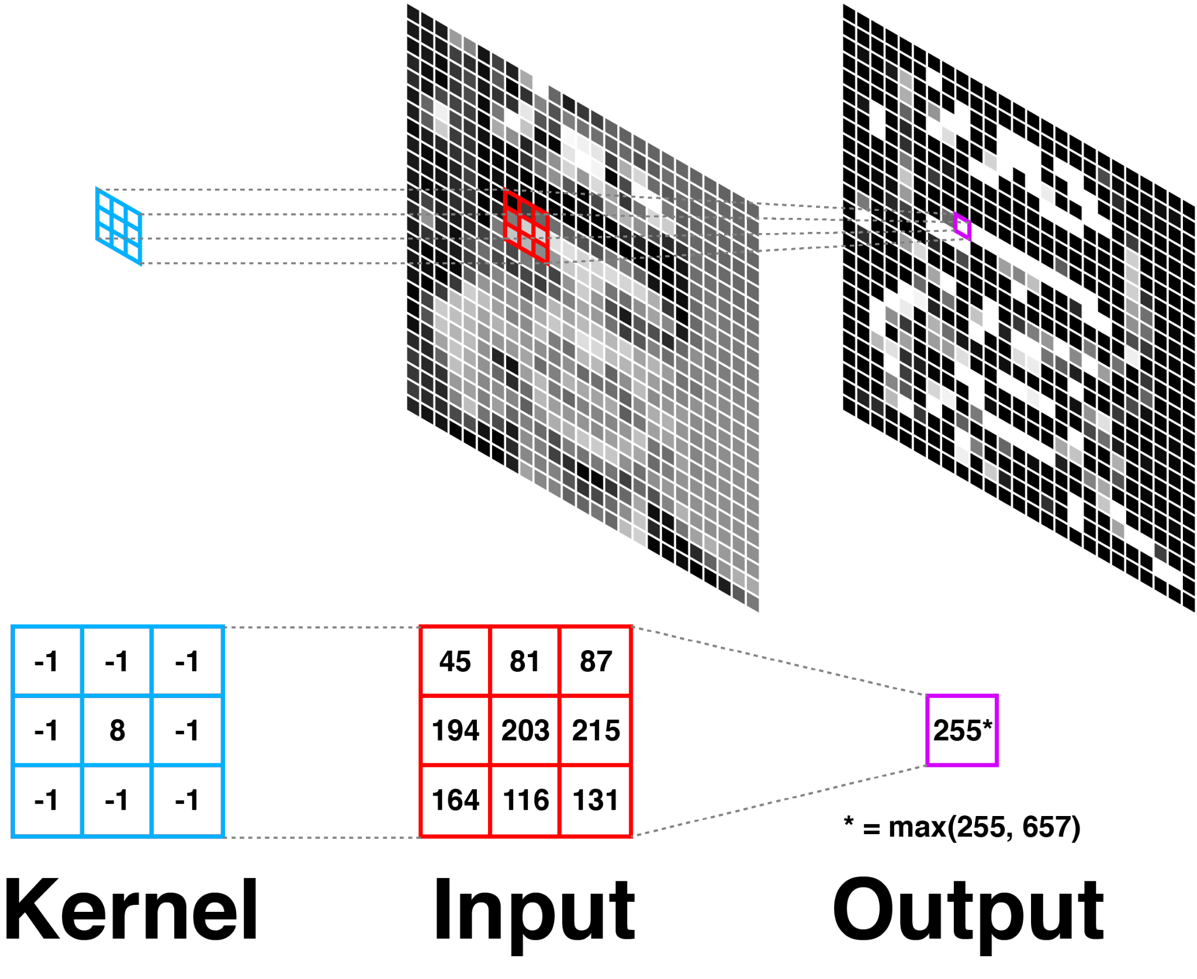
Convolutions

Slide 30
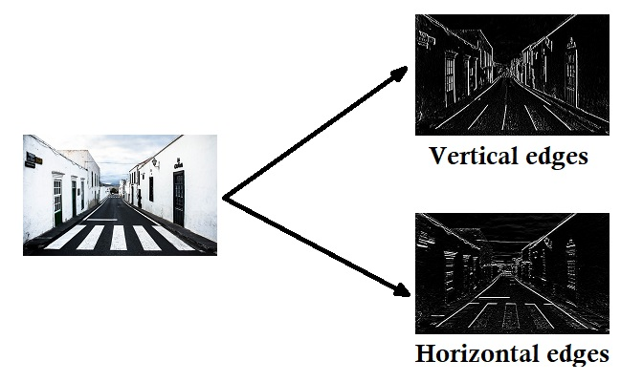
Convolutions

Slide 31
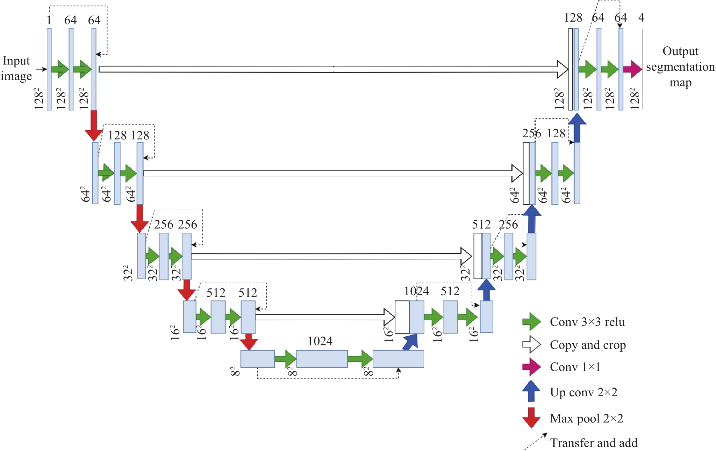
What is a UNet

Slide 32
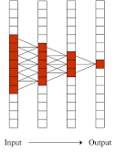
A Problem: Receptive Field

Slide 33
Adding Attention

Slide 34
The Best Model: UNet (+ Attention)
Pros:
Can see a lot of the data at once (large receptive field)
Powerful
Cons:
Can memorize the training data (overfitting)

Slide 35
The Best Model: UNet (+ Attention)
Accuracy: ~82%
F1 score by waveform type:
 | J | K | L | M | N | W
UNet | 0.88 | 0.67 | 0.83 | 0.87 | 0.32 | 0.62

Slide 36
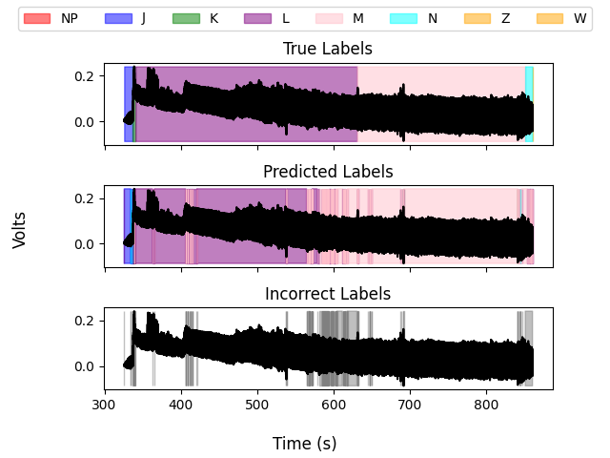
The Best Model: UNet (+ Attention)
Observe barcodes

Slide 37
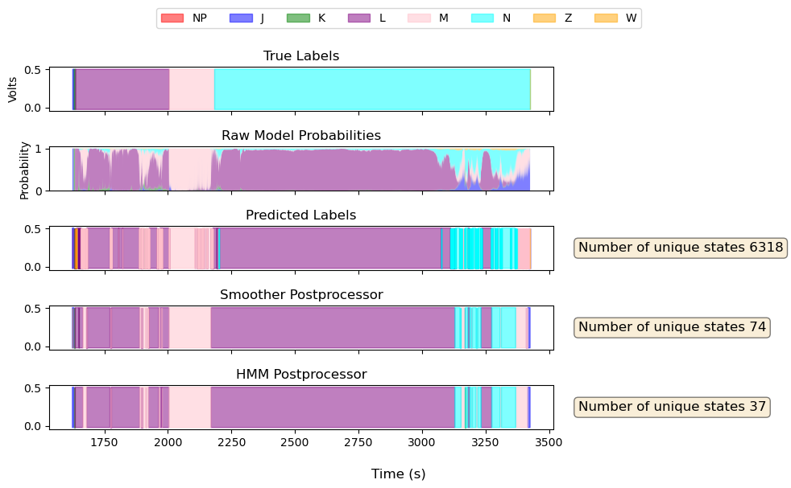
Post Processing
Problem: “Barcodes”
Solutions
Smoothing filter
Barcode cutter
HMM
HSMM
Project for next interns

Slide 38
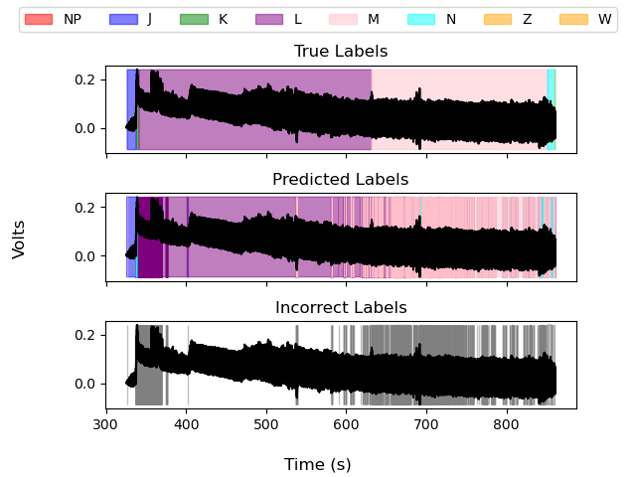
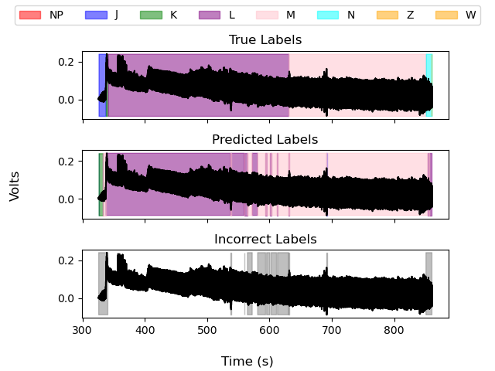
Example: HMM Postprocessor

Slide 39
Limitations
Liaisons are experts in biology but not computer science
Model output is never perfect, needs some manual adjustment
Important to convey system limitations
Potential for negative impact on science if blindly trusted

Slide 40
Future Work
User Interface
Make more comprehensive by integrating live view
Render long recordings more efficiently
Integrate post-processing
Machine Learning
Other post-processing and data augmentation methods
Adapt models for other insects

Slide 41
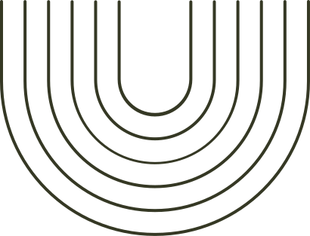
Your name or organization
Thank you!
Questions/comments/suggestions?
We’d love to touch on ML models we’ve tried or the project’s future!
Acknowledgements
USDA (58-2034-3-445)
USDA (58-3022-4-034)
NSF (DBI - 2304787)

